Slide 1

What is the thing you’re most scared of?

Slide 2

HOMICIDE INVESTIGATION REPORT
Group 7: Sam Malcolm, Maggie Yu, Evan David, Kirti Pande
Notes:
Sam

Slide 3

The department of justice is relying on the analysis of the 4 of us….
To allocate more reinforcements to police departments across the cities of The United States

Slide 4

Which cities are unsafe?
Let’s find out…

Slide 5


DATA
OBJECTIVE
52k+ rows of data across 50 American cities
Population and crime rate across states
11 variables describing the victim, location and date when the body was recovered
Disposition of the homicide case whether the case is Open/Closed.
Identify the locations based on the number of homicides and homicide/population
Understand the regions where the cases are not being closed effectively
Observe trends across demography
Time-wise trends for identified locations and demography
Notes:
Sam

Slide 6
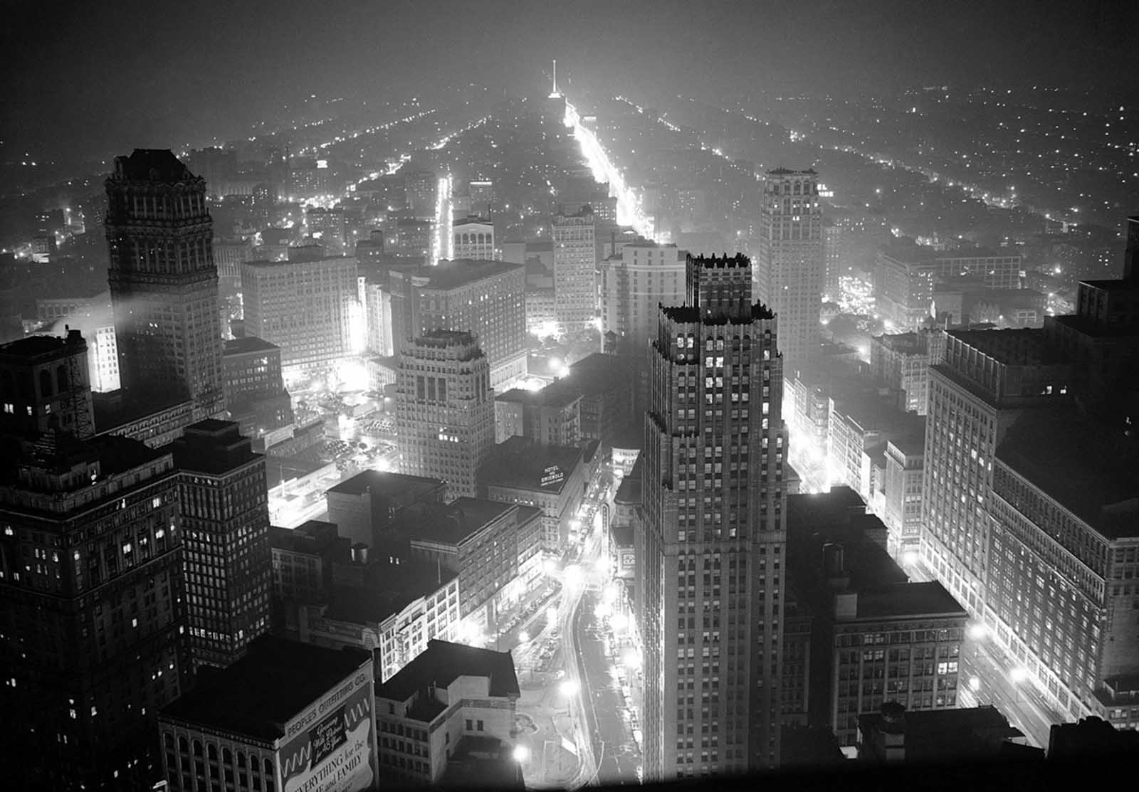
Exploratory Data Analysis
Notes:
Evan

Slide 7
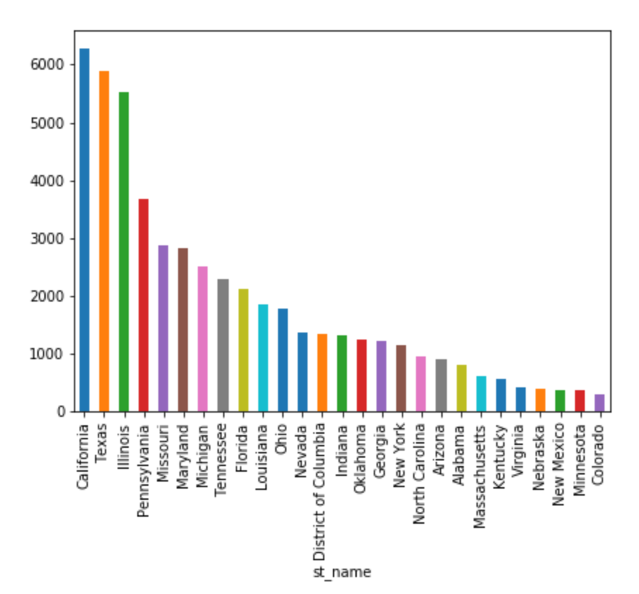
Homicides by state

Slide 8
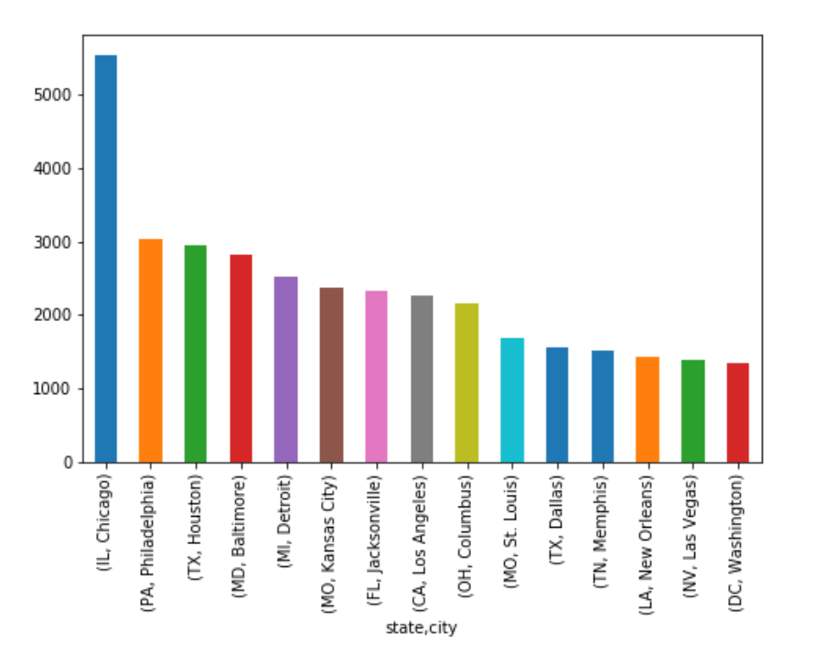
Homicides by city

Slide 9
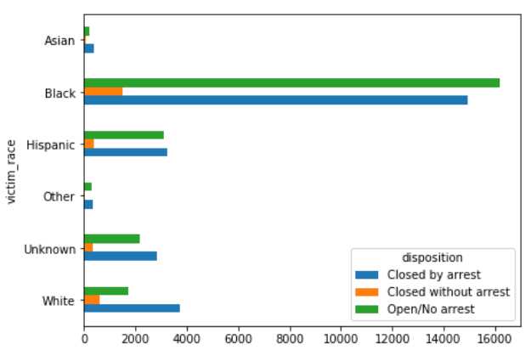
African Americans not only are the most frequent victims of homicide, they have the worst ratio of cases being solved

Slide 10
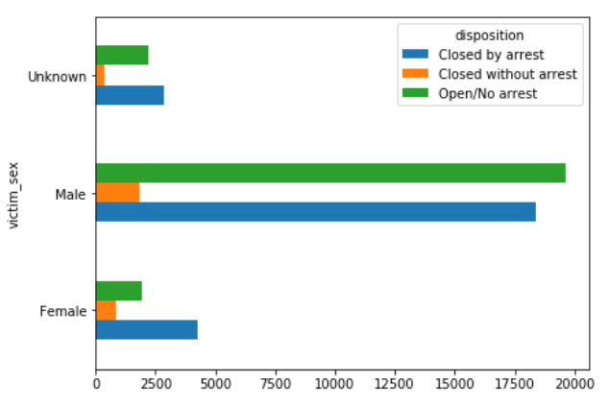
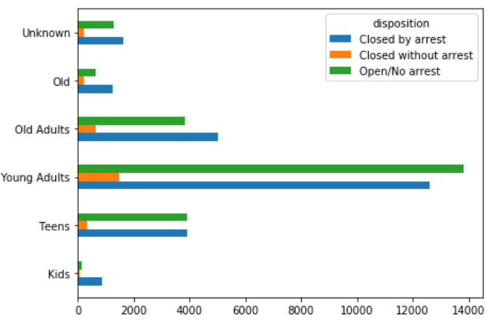
This is also true for young adults (20s and 30s) and males

Slide 11
This is also true for young adults (20s and 30s) and males

Slide 12
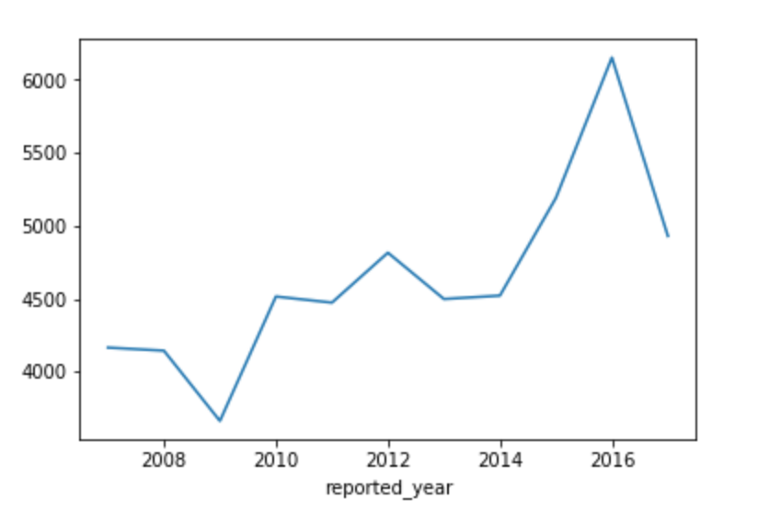
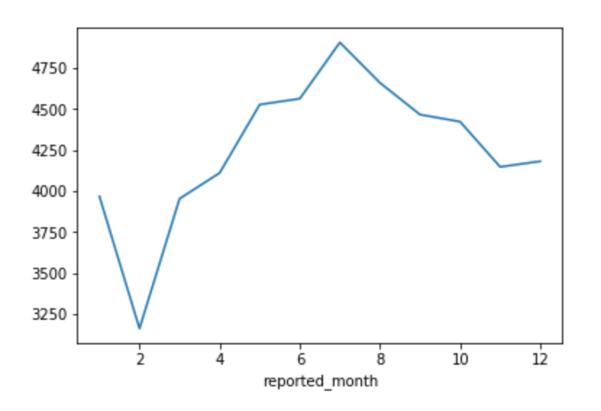
Homicide trends over time
Notes:
Add titles

Slide 13
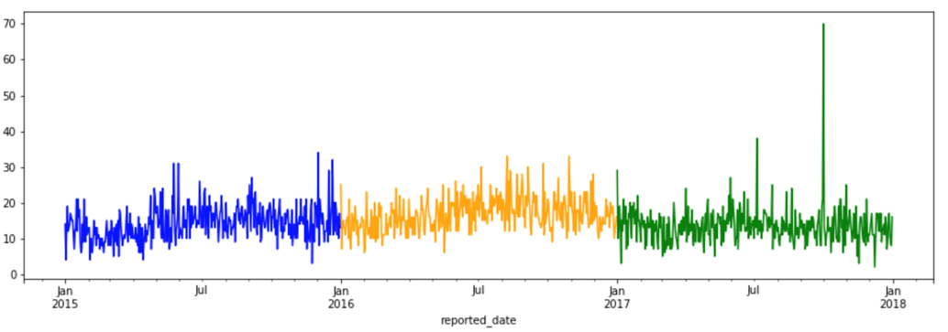
Daily homicides in the last 3 years
Las Vegas shooting
Notes:
Add animation of LV shooting

Slide 14
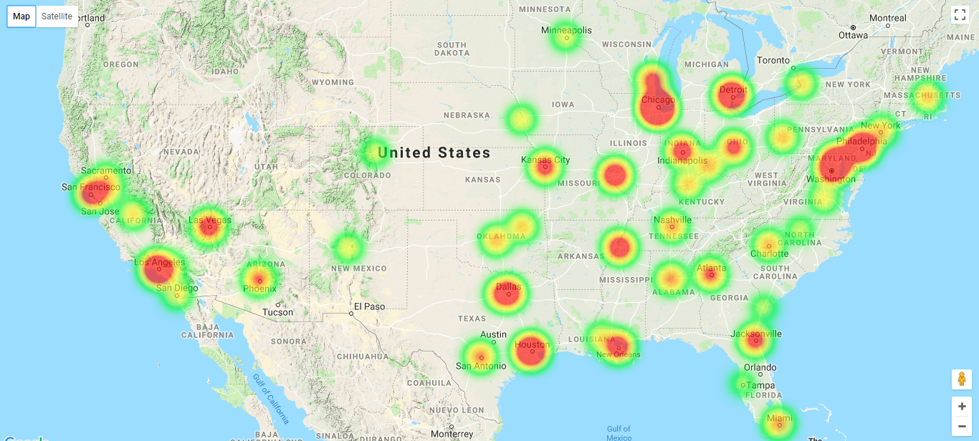
Total homicides
Notes:
Evan

Slide 15
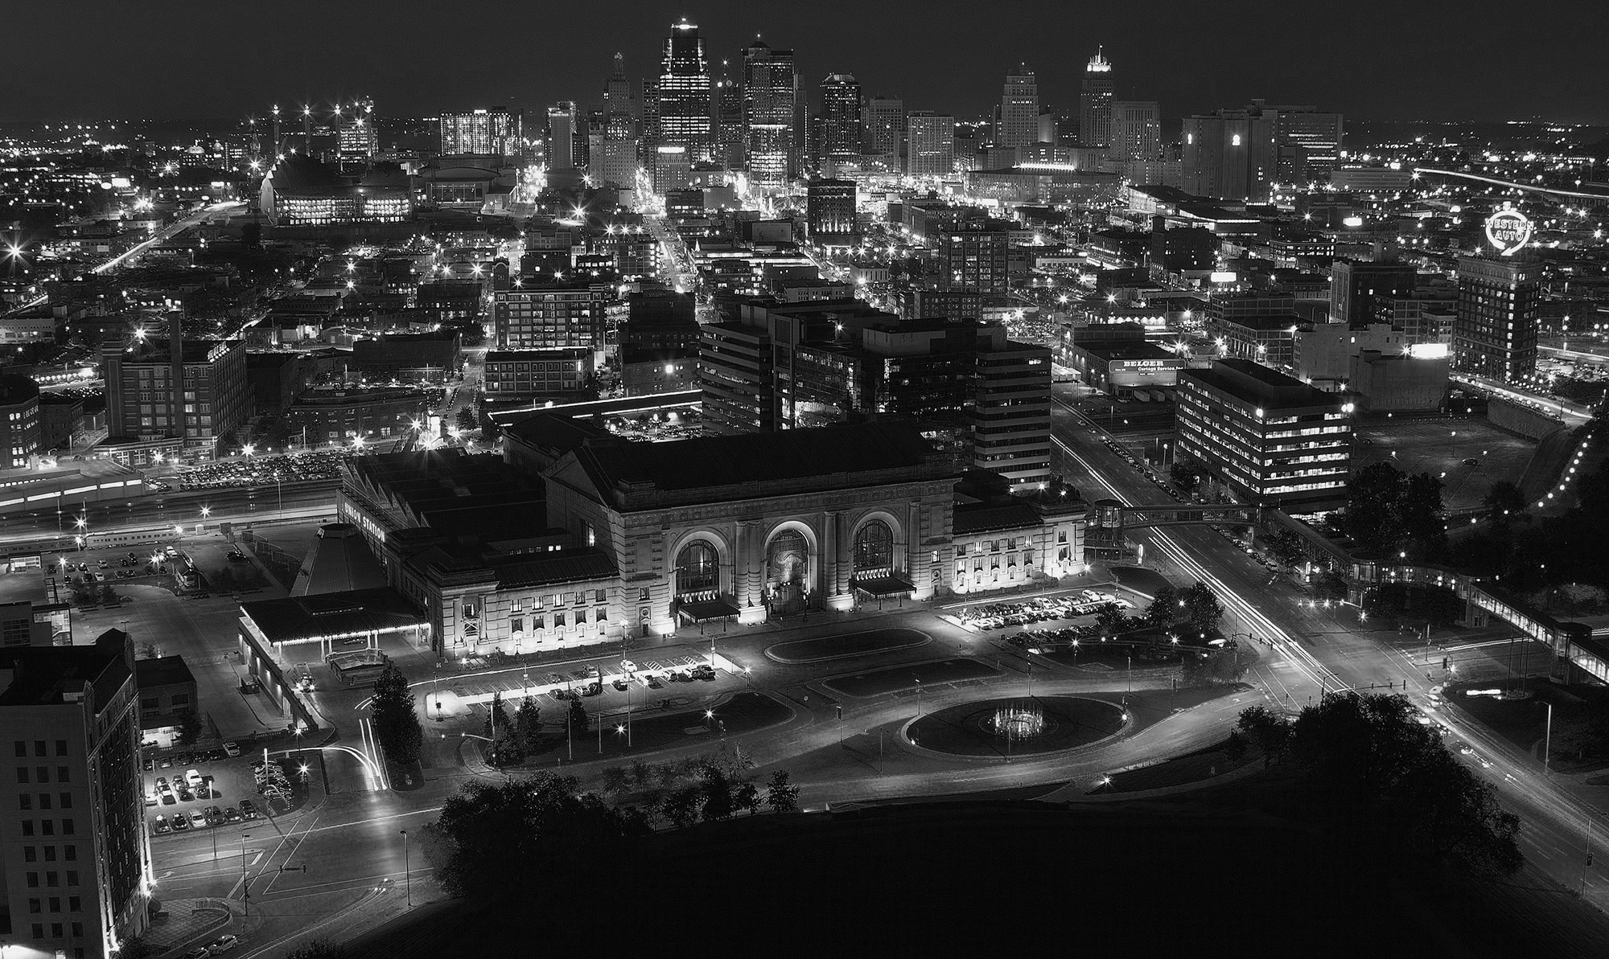
Solutions and Insights
Notes:
When evaluating how to allocate federal resources, we want to consider two different metrics. First, where are homicides occurring most frequently? It is in these areas that we hope to make an effect via prevention. Second, where are homicide cases not being solved? Here is where we can make a significant improvement in investigation and closure.

Slide 16
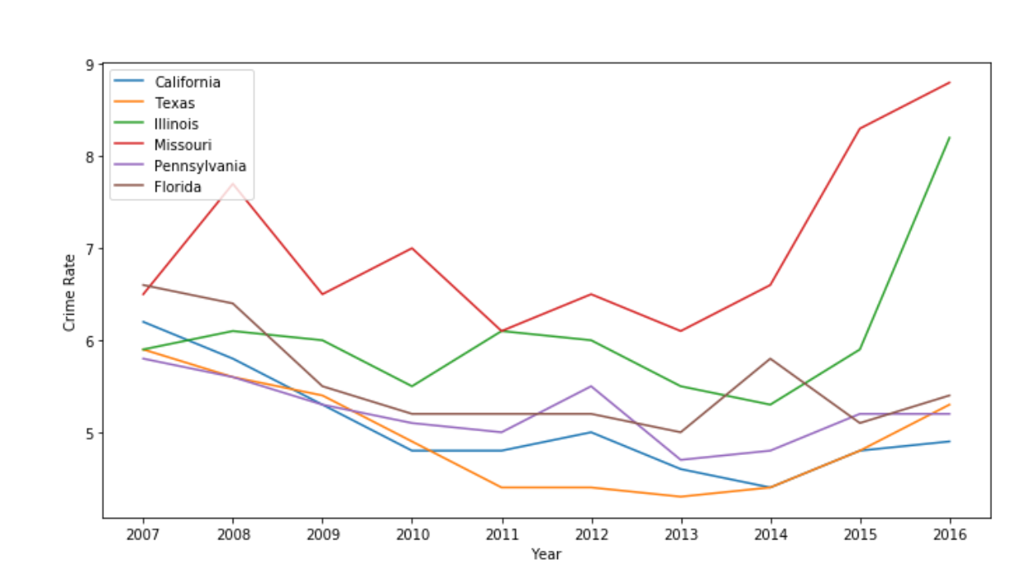
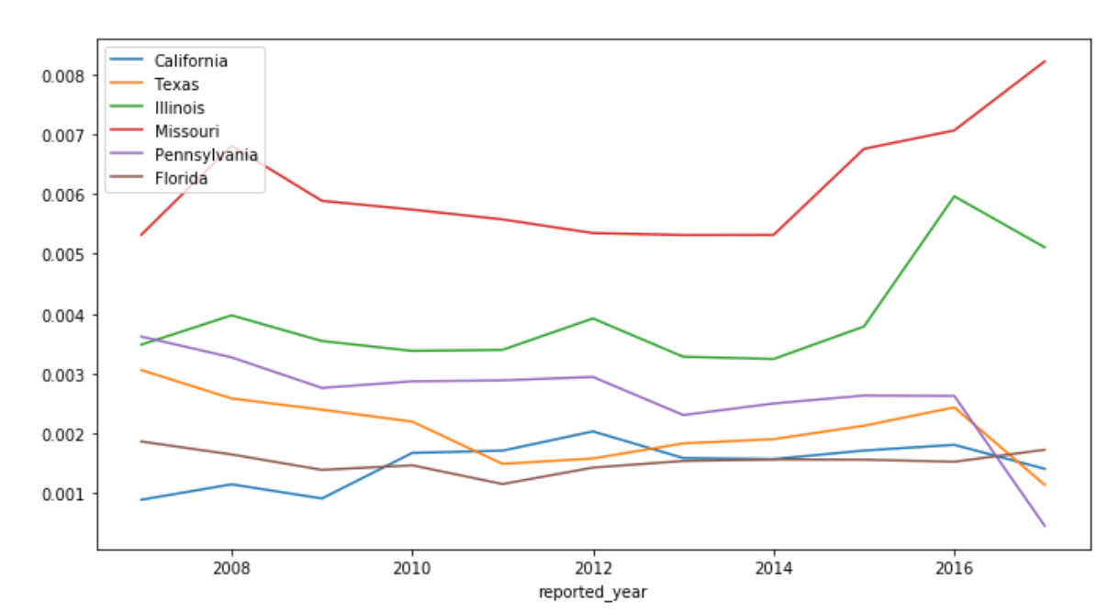
State homicide %
State crime Rate
Missouri turns out to be state with the highest percentage of homicides and FBI crime rate
Notes:
From our EDA, we selected top 6 states based on the volume of homicides. The plot on the left shows the homicide rate over 10 years and the plot on the right shows the FBI crime rate on these states in the same time range. We can find the Missouri stands out of both plots.

Slide 17
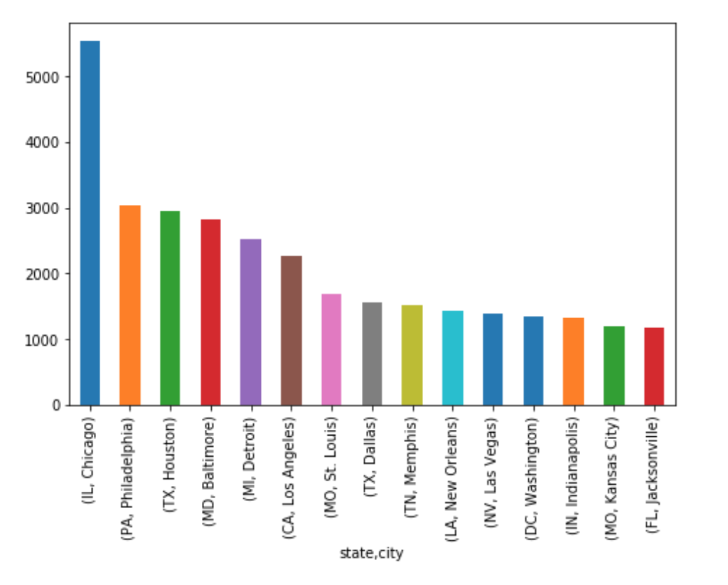
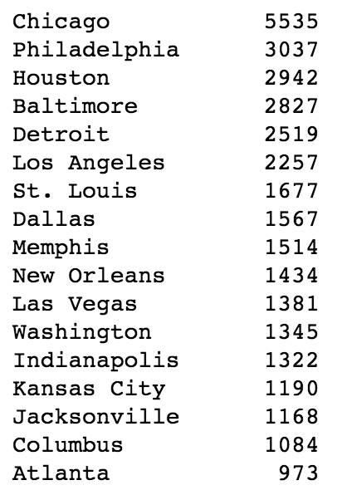
Chicago is the city with highest number of homicides recorded.
However, on comparing to the population of the respective states…
Notes:
Then, speaking of the number of homicides on each city, Chicago is top one on the list and much higher than any other cities.

Slide 18
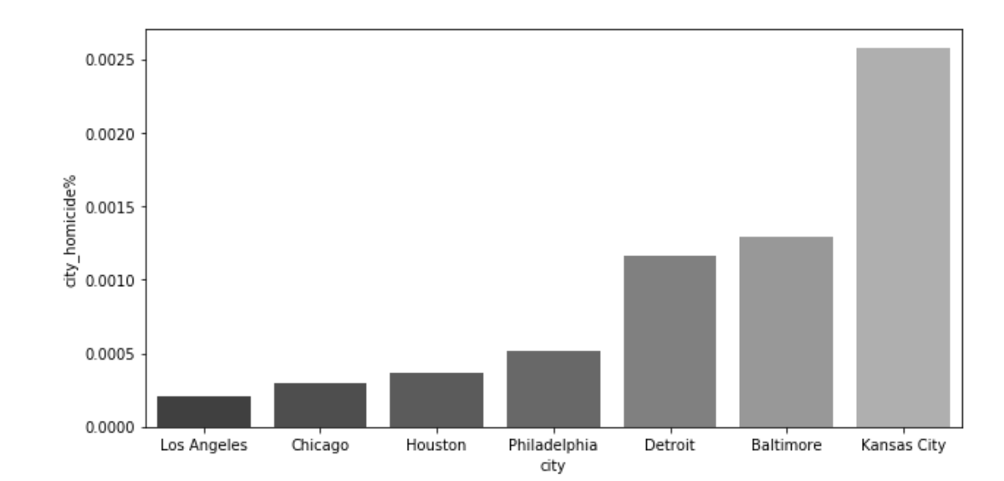
Kansas City turns out to be the city with highest homicide rate
This also explains why Missouri was the top state with the highest homicide rate
Notes:
However, on comparing to the population of the respective states, Kansas City turns out to be the city with highest homicide rate. And this explains why Missouri was the top state with the highest homicide rate.

Slide 19
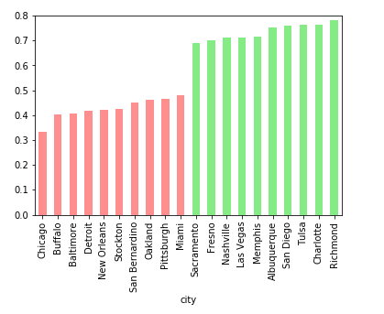
Closure Rate
Disparity between best and worst closure rates by city
Notes:
This plot shows the disparity of closure rates between top 10 and last 10 cities. Here we can see some familiar names like Chicago (worst again!), Baltimore, Detroit.

Slide 20
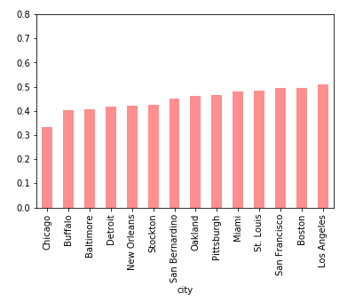
Closure Rate
14 cities with closure rates <= 50%
Notes:
Here we want to explore more on the effectiveness, so we take a closer look at the cities with closure rate lower than 50%.

Slide 21
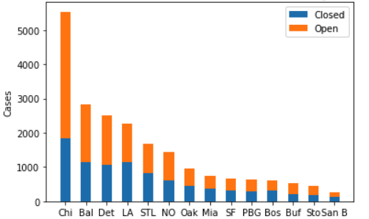
Sorted by volume of homicides
Notes:
When we look at the volume of homicides again we have the stacked plot regarding of open and closed cases this time and you can have a more intuitive idea of how unsafe these cities can be.

Slide 22
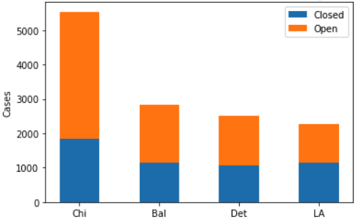
Sorted by Volume
4 Worst Performing Cities - Chicago - Baltimore - Detroit - Los Angeles
Notes:
Based on the analysis above, we found 4 worst performing cities which are Chicago, Baltimore, Detroit and Los Angeles.

Slide 23
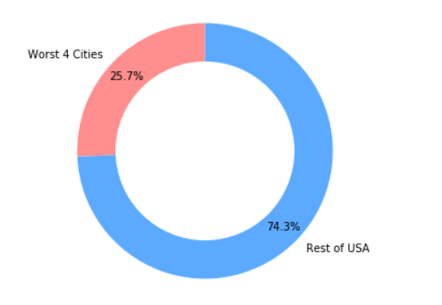
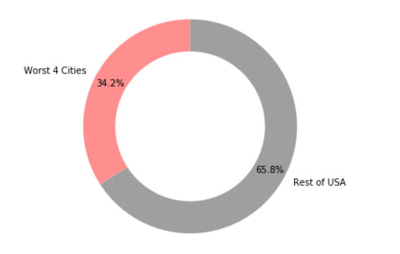
Total Homicides
Total Open Cases
4 Worst Performing Cities
Account for 1/4 of all homicides…
…but 1/3 of all open cases in the data
Notes:
These 4 cities account for nearly ¼ of all homicides, but 1/3 of all open cases in the data.

Slide 24
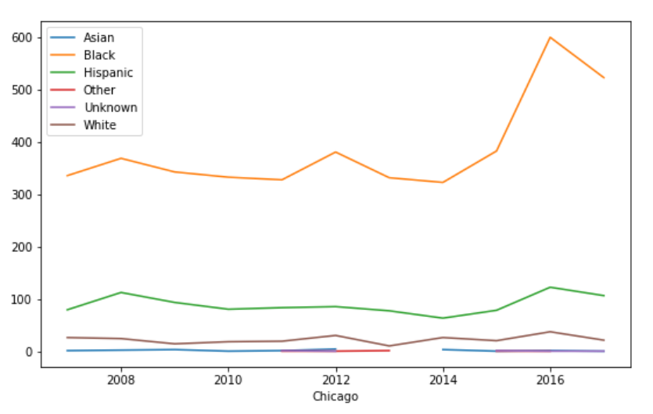
Chicago
Race | Predominantly African Americans followed by Hispanics
Age | Early 20s and teens
Sex | Males
Heat Map/scatter plot | North and central Chicago are safer
2018 prediction | Predict more homicides than the previous year, especially last quarter
Notes:
Kirti

Slide 25
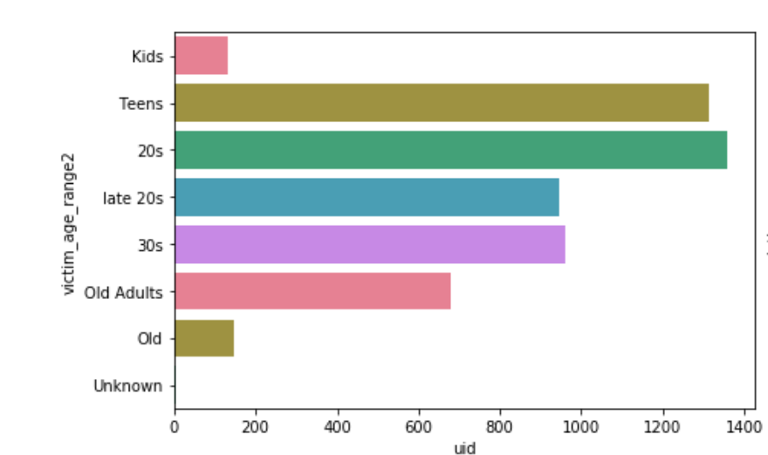
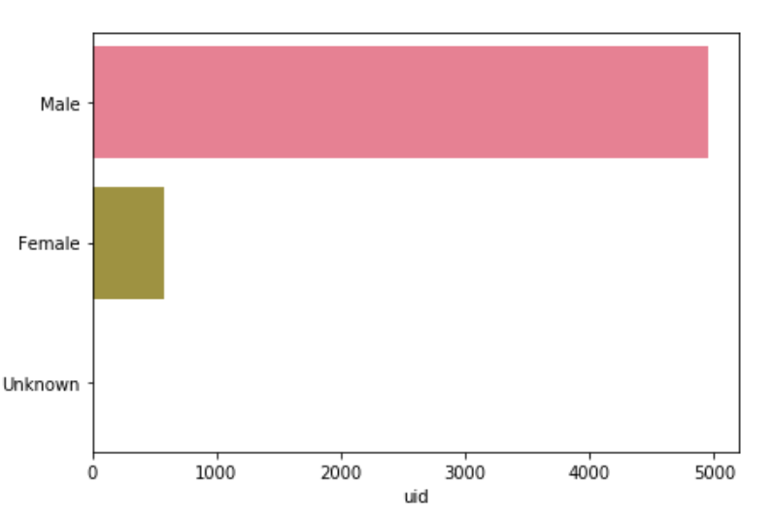
Chicago
Race | Predominantly African Americans followed by Hispanics
Age | Early 20s and teens
Sex | Males
Heat Map/scatter plot | North and central Chicago are safer
2018 prediction | Predict more homicides than the previous year, especially last quarter
Age groups
Sex

Slide 26
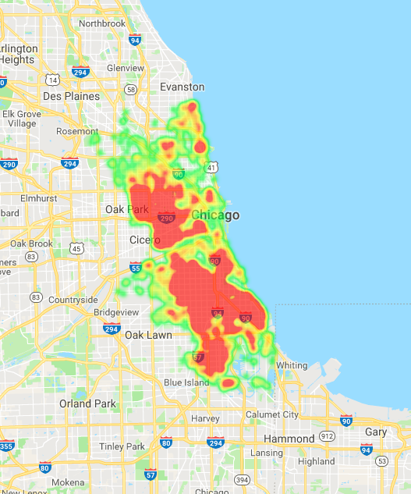
Chicago
Race | Predominantly African Americans followed by Hispanics
Age | Early 20s and teens
Sex | Males
Heat Map/scatter plot | North and central Chicago are safer
2018 prediction | Predict more homicides than the previous year, especially last quarter

Slide 27
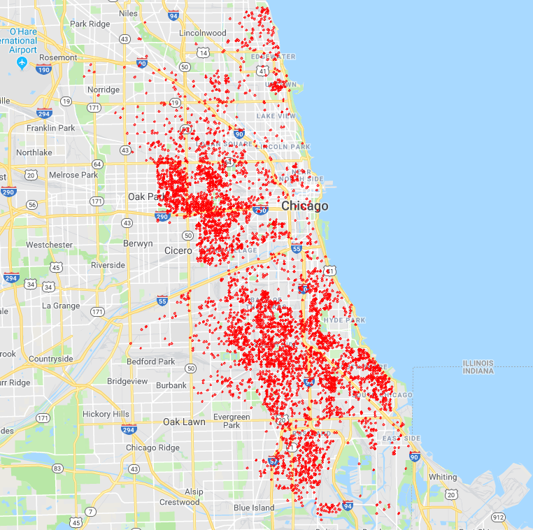
Chicago
Race | Predominantly African Americans followed by Hispanics
Age | Early 20s and teens
Sex | Males
Heat Map/scatter plot | North and central Chicago are safer
2018 prediction | Predict more homicides than the previous year, especially last quarter

Slide 28
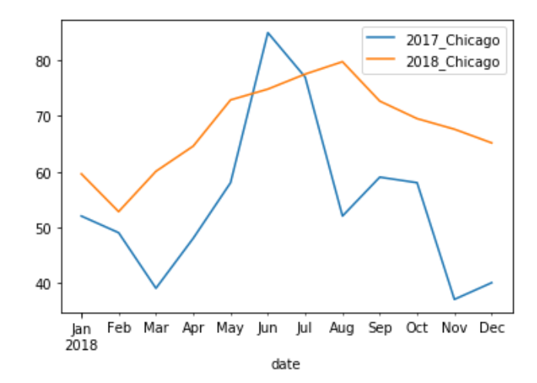
Chicago
Race | Predominantly African Americans followed by Hispanics
Age | Early 20s and teens
Sex | Males
Heat Map/scatter plot | North and central Chicago are safer
2018 prediction | Predict more homicides than the previous year, especially last quarter

Slide 29
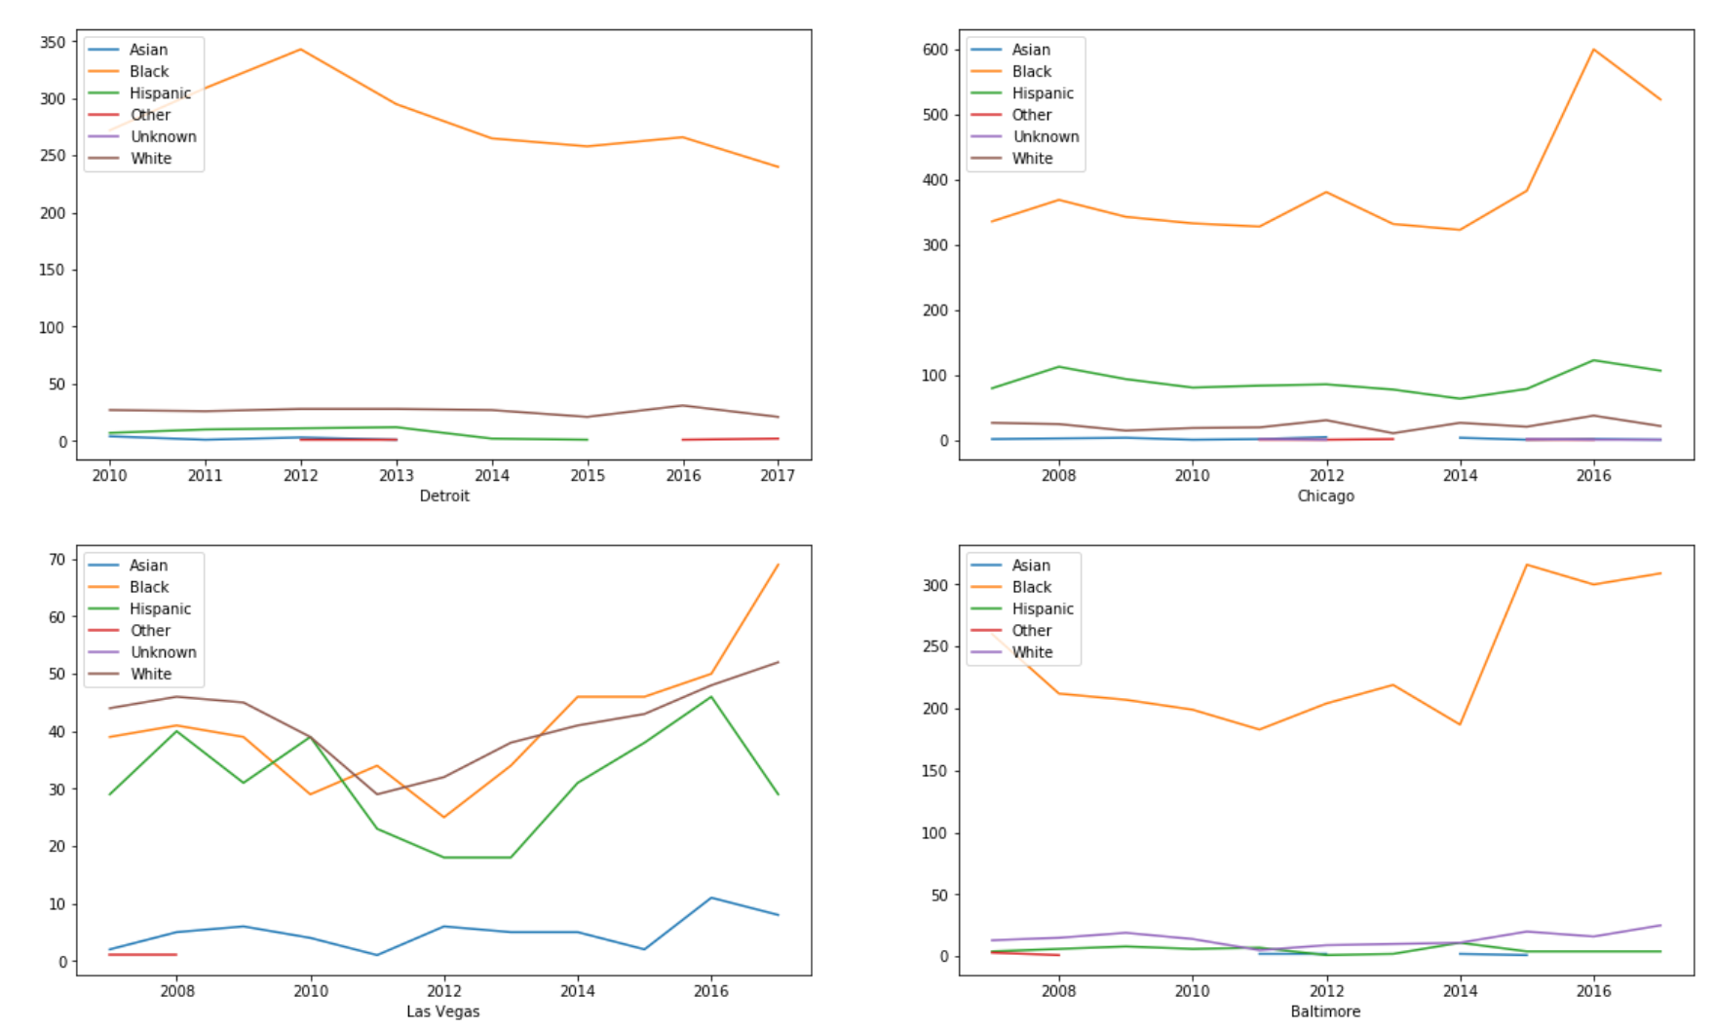
Detroit
Race | Predominantly African Americans hardly any Asians since 2012!
Age | Old Adults (40-60) more highly represented, followed by early 20s
Sex | Males
Heat Map/scatter plot | Evenly spread out among the neighborhoods in Detroit
2018 prediction | Predict more homicides than the previous year Increases post dip in October 2018

Slide 30
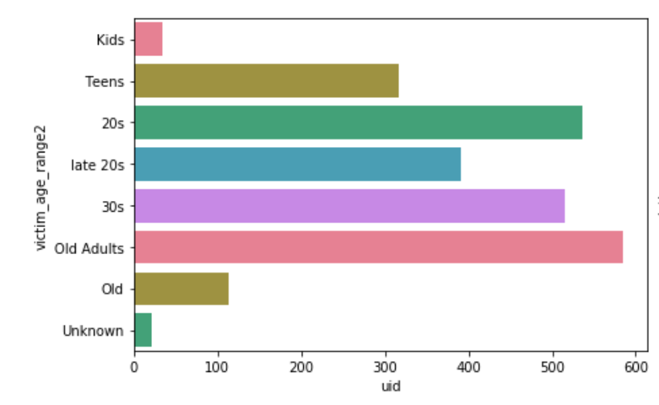
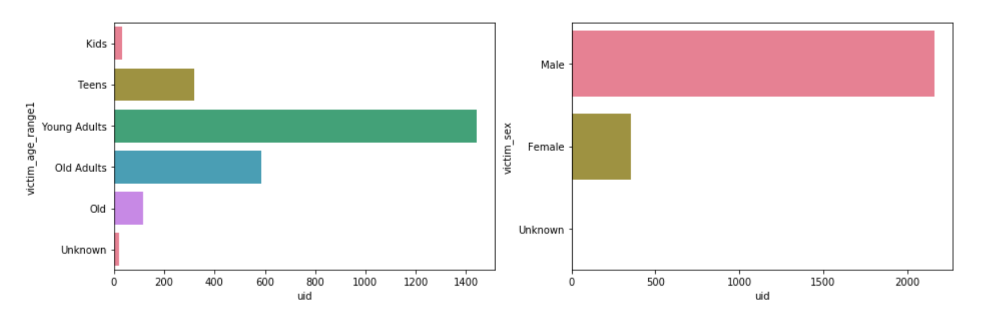
Detroit
Race | Predominantly African Americans hardly any Asians since 2012!
Age | Old Adults (40-60) more highly represented, followed by early 20s
Sex | Males
Heat Map/scatter plot | Evenly spread out among the neighborhoods in Detroit
2018 prediction | Predict more homicides than the previous year Increases post dip in October 2018
Age groups
Sex

Slide 31
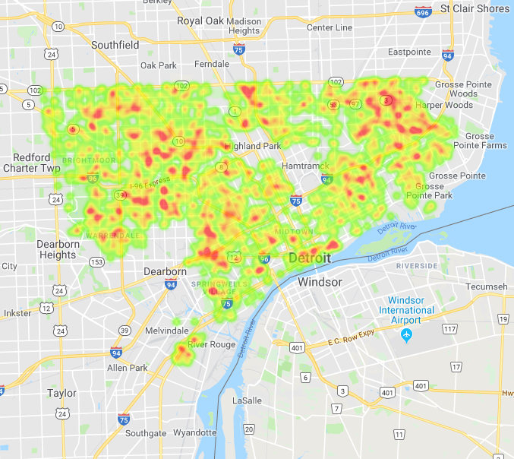
Detroit
Race | Predominantly African Americans hardly any Asians since 2012!
Age | Old Adults (40-60) more highly represented, followed by early 20s
Sex | Males
Heat Map/scatter plot | Evenly spread out among the neighborhoods in Detroit
2018 prediction | Predict more homicides than the previous year Increases post dip in October 2018
Notes:
Add animation to point out the area

Slide 32
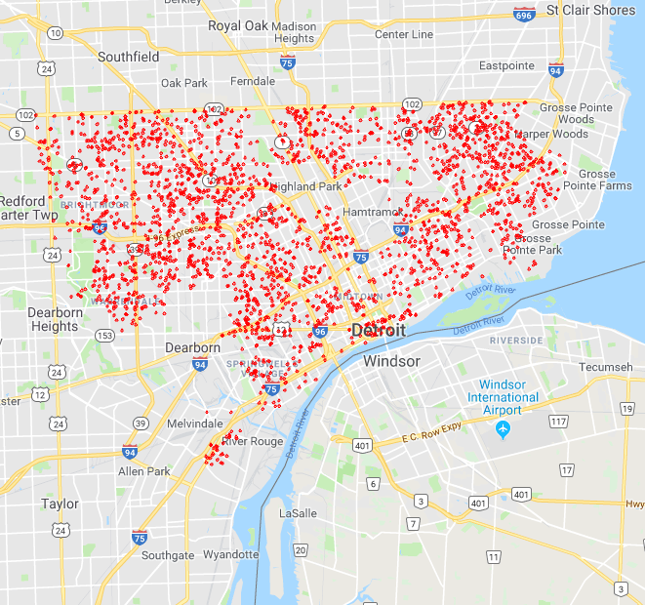
Detroit
Race | Predominantly African Americans hardly any Asians since 2012!
Age | Old Adults (40-60) more highly represented, followed by early 20s
Sex | Males
Heat Map/scatter plot | Evenly spread out among the neighborhoods in Detroit
2018 prediction | Predict more homicides than the previous year Increases post dip in October 2018

Slide 33
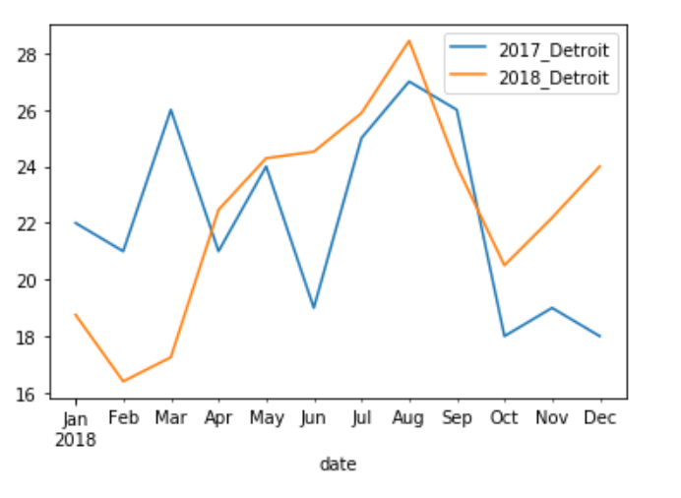
Detroit
Race | Predominantly African Americans hardly any Asians since 2012!
Age | Old Adults (40-60) more highly represented, followed by early 20s
Sex | Males
Heat Map/scatter plot | Evenly spread out among the neighborhoods in Detroit
2018 prediction | Predict more homicides than the previous year Increases post dip in October 2018

Slide 34
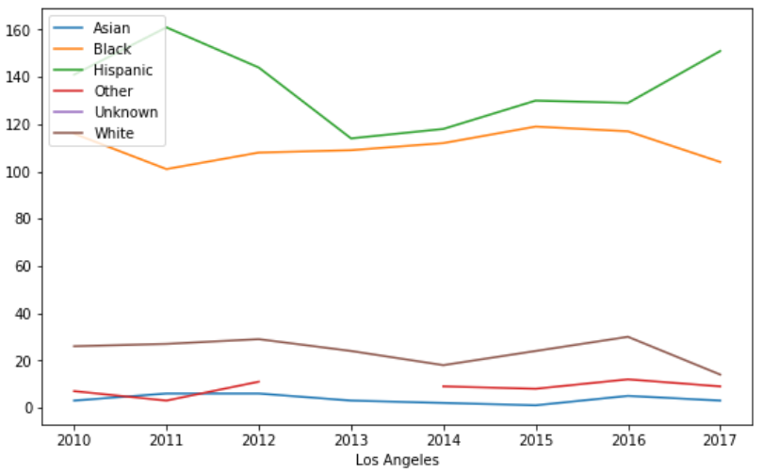
Los Angeles
Race | Predominantly Hispanic followed by African Americans!
Age | Old Adults (40-60) more highly represented, followed by 30s
Sex | Males
Heat Map/scatter plot | South LA, Chinatown, and downtown have the most homicides
2018 prediction | Predict the same trends as the previous year

Slide 35
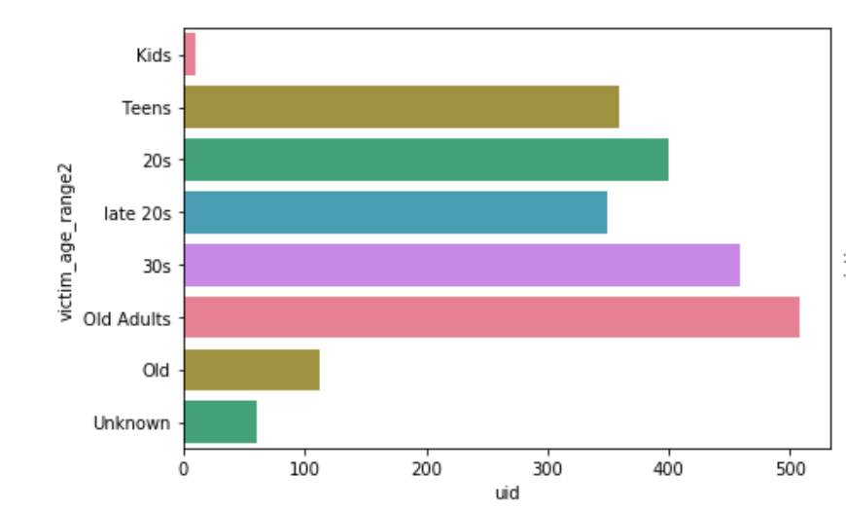
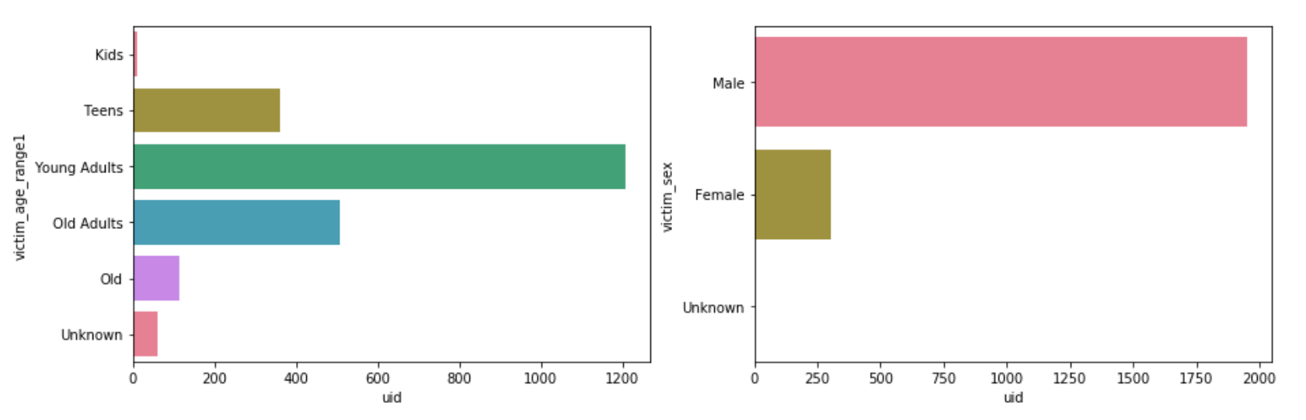
Los Angeles
Race | Predominantly Hispanic followed by African Americans!
Age | Old Adults (40-60) more highly represented, followed by 30s
Sex | Males
Heat Map/scatter plot | South LA, Chinatown, and downtown have the most homicides
2018 prediction | Predict the same trends as the previous year
Age groups
Sex

Slide 36
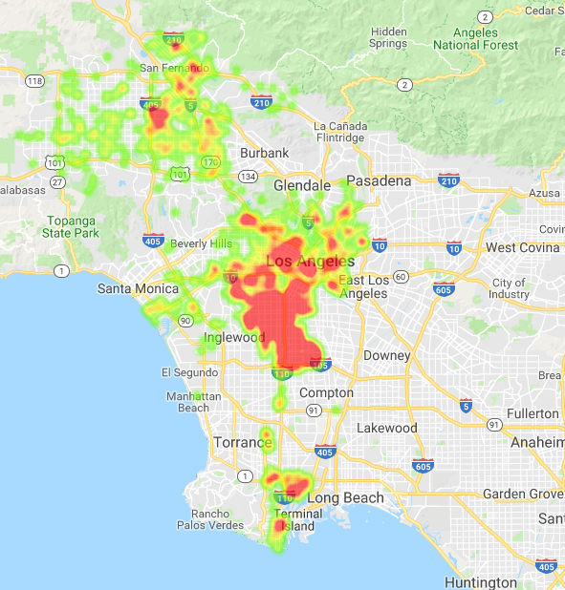
Los Angeles
Race | Predominantly Hispanic followed by African Americans!
Age | Old Adults (40-60) more highly represented, followed by 30s
Sex | Males
Heat Map/scatter plot | South LA, Chinatown, and downtown have the most homicides
2018 prediction | Predict the same trends as the previous year

Slide 37
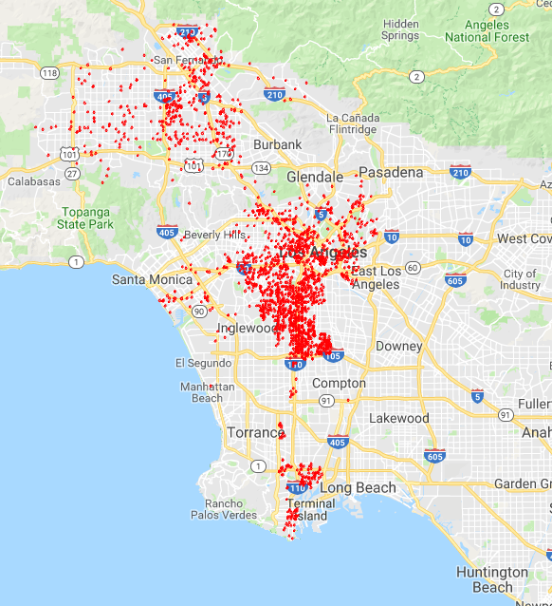
Los Angeles
Race | Predominantly Hispanic followed by African Americans!
Age | Old Adults (40-60) more highly represented, followed by 30s
Sex | Males
Heat Map/scatter plot | South LA, Chinatown, and downtown have the most homicides
2018 prediction | Predict the same trends as the previous year

Slide 38
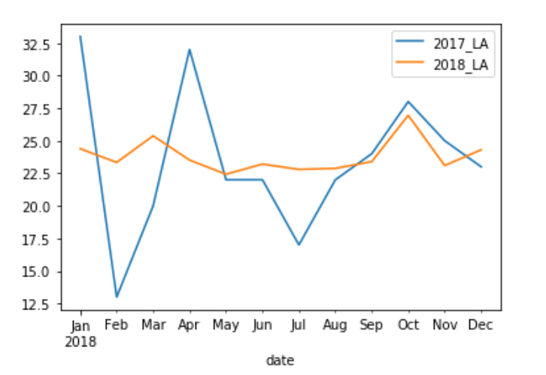
Los Angeles
Race | Predominantly Hispanic followed by African Americans!
Age | Old Adults (40-60) more highly represented, followed by 30s
Sex | Males
Heat Map/scatter plot | South LA, Chinatown, and downtown have the most homicides
2018 prediction | Predict the same trends as the previous year

Slide 39
Baltimore
Race | Predominantly African Americans
Age | Predominantly early 20s followed by 30s
Sex | Males
Heat Map/scatter plot | Roland Park, Hampden are higher income, predominantly white – very low homicide count
2018 prediction | Predict more steady homicide counts – no drop off like 2017

Slide 40
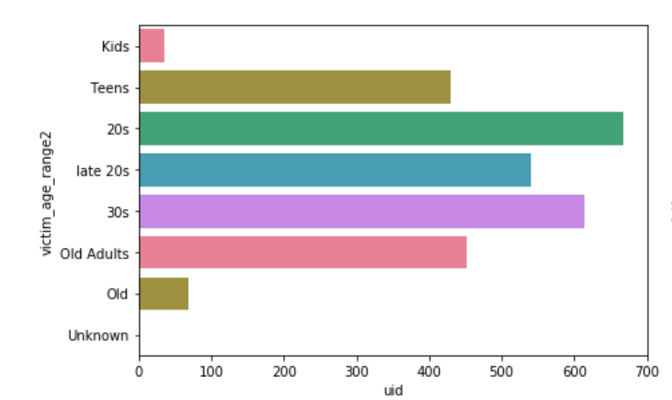
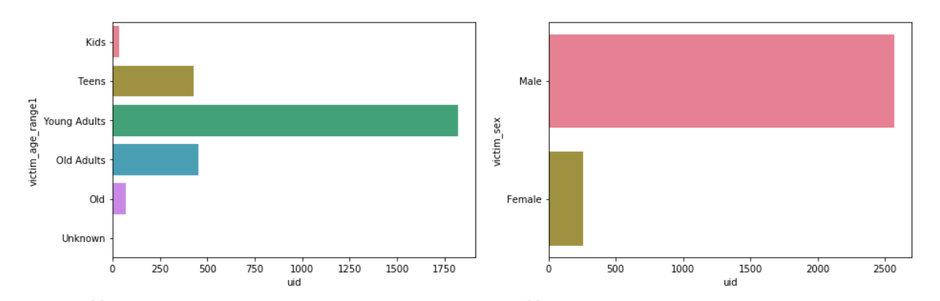
Baltimore
Race | Predominantly African Americans
Age | Predominantly early 20s followed by 30s
Sex | Males
Heat Map/scatter plot | Roland Park, Hampden are higher income, predominantly white – very low homicide count
2018 prediction | Predict more steady homicide counts – no drop off like 2017
Age groups
Sex

Slide 41
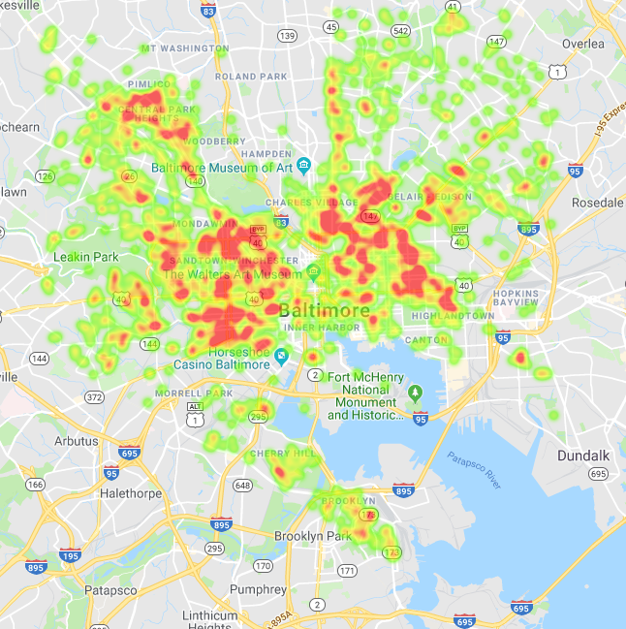
Baltimore
Race | Predominantly African Americans
Age | Predominantly early 20s followed by 30s
Sex | Males
Heat Map/scatter plot | Roland Park, Hampden are higher income, predominantly white – very low homicide count
2018 prediction | Predict more steady homicide counts – no drop off like 2017

Slide 42
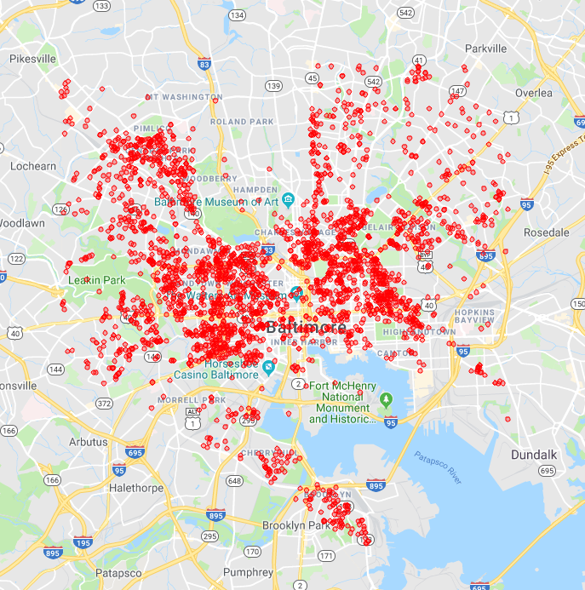
Baltimore
Race | Predominantly African Americans
Age | Predominantly early 20s followed by 30s
Sex | Males
Heat Map/scatter plot | Roland Park, Hampden are higher income, predominantly white – very low homicide count
2018 prediction | Predict more steady homicide counts – no drop off like 2017

Slide 43
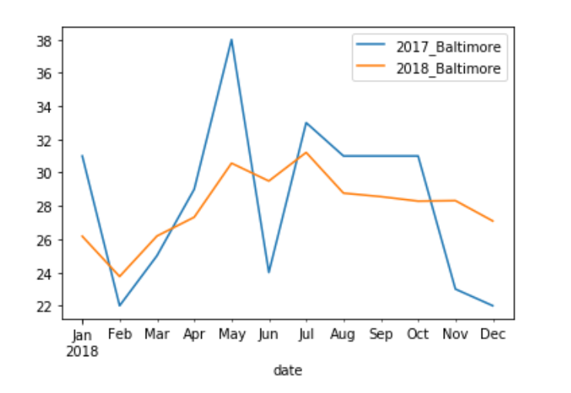
Baltimore
Race | Predominantly African Americans
Age | Predominantly early 20s followed by 30s
Sex | Males
Heat Map/scatter plot | Roland Park, Hampden are higher income, predominantly white – very low homicide count
2018 prediction | Predict more steady homicide counts – no drop off like 2017
Notes:
Kirti

Slide 44
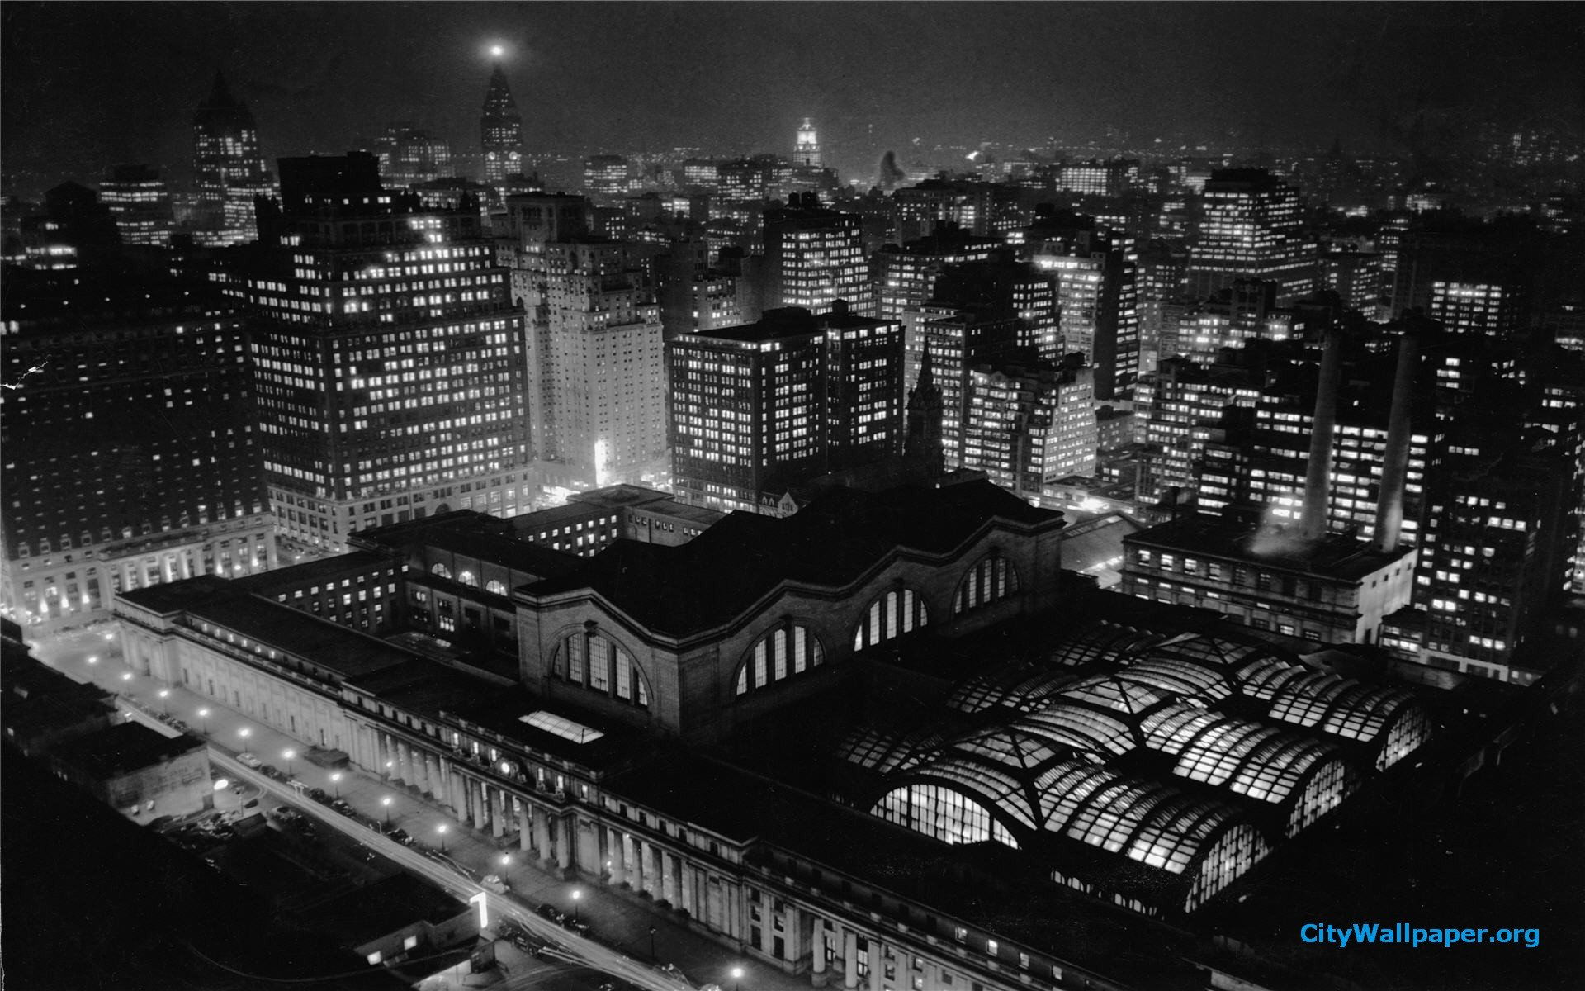
Final Insights
Notes:
Sam

Slide 45
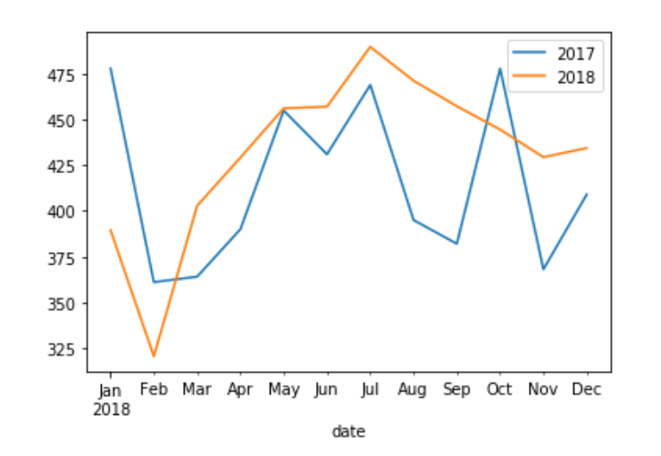
Prediction of 2018

Slide 46
Final Insights:
Overall homicides in 2018 predicted to be higher than 2017
Cities of Baltimore, Chicago, Detroit and Los Angeles identified as requiring highest attention based on homicide rate and lowest closure rates
Regions with highest homicides in these cities have a higher population of African Americans/presence of gangs and lower socio economic conditions
A rise in homicides is observed in the months of Sept onwards in these cities in comparison to 2017
Younger population especially early 20s have higher homicide numbers

Slide 47
Suggestions:
Allocations of resources capable in handling gang violence in neighborhoods identified
Resources to be allocated in the next 2 months to the identified cities since homicides are expected to increase
Focus on areas with lower socio economic conditions and allocation of resources capable of handling such areas
Inclusion of advanced forces to hard hitting neighborhoods like Chinatown & Downtown , LA and South-side, Chicago

Slide 48
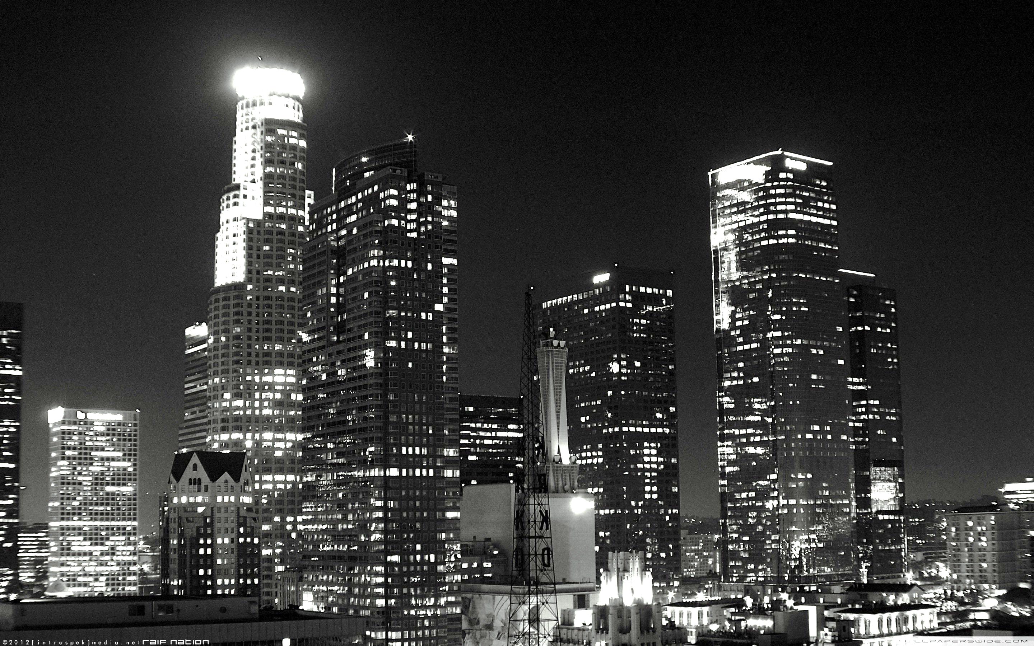
Thank you!
LA
Notes:
Sam

